Slide 1
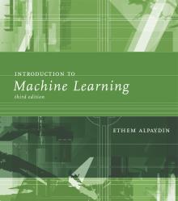
INTRODUCTION TO Machine Learning 3rd Edition
Lecture Slides for
ETHEM ALPAYDIN
© The MIT Press, 2014
alpaydin@boun.edu.tr
http://www.cmpe.boun.edu.tr/~ethem/i2ml3e

Slide 2
CHAPTER 6: Dimensionality Reduction

Slide 3
Why Reduce Dimensionality?
Reduces time complexity: Less computation
Reduces space complexity: Fewer parameters
Saves the cost of observing the feature
Simpler models are more robust on small datasets
More interpretable; simpler explanation
Data visualization (structure, groups, outliers, etc) if plotted in 2 or 3 dimensions

Slide 4
Feature Selection vs Extraction
Feature selection: Choosing k<d important features, ignoring the remaining d – k
Subset selection algorithms
Feature extraction: Project the
original x_{i} , i =1,...,d dimensions to
new k<d dimensions, z_{j} , j =1,...,k

Slide 5
Principal Component Analysis
Very important and powerful tool for multivariate data analysis, feature extraction and visualisation.
Complex data can be trimmed down to only useful information that matters.
The idea is simple yet effective.

Slide 6
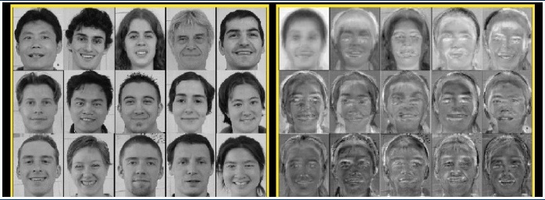
Principal Component Analysis
Facial Recognition
Faces
Eigenfaces

Slide 7
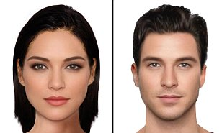
Principal Component Analysis
Facial Recognition

Slide 8
Principal Component Analysis
Facial Recognition
Eigen Vectors/ Principal Components

Slide 9
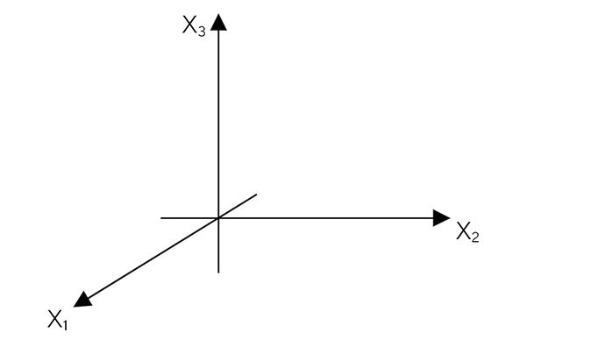
Principal Component Analysis
Suppose we have a data matrix X with N observations and d dimensions. Suppose d = 3 for simplicity in visualisation.

Slide 10
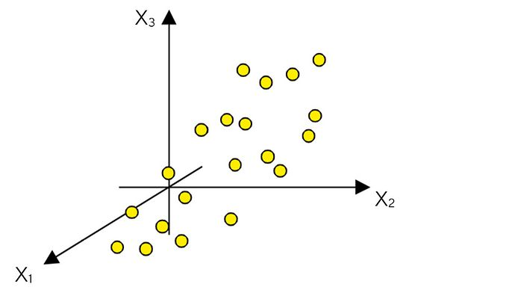
Principal Component Analysis
import numpy as np
import scipy.io
import matplotlib.pyplot as plt
# Step 1: Load the data
iris_data = scipy.io.loadmat('iris_data.mat')
X = iris_data['iris'][:, :4]
L = iris_data['iris'][:, -1]
nd = 3 # New Dimension
Let’s plot the data.

Slide 11
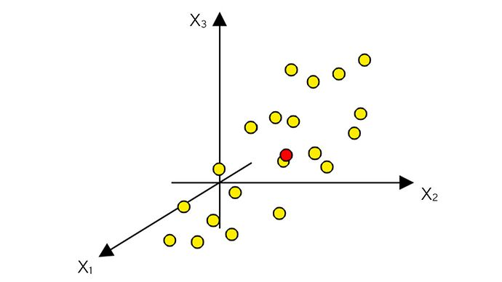
Principal Component Analysis
Find out the mean, a centre point. Shown in RED
# Center the data
Xmean = np.mean(X, axis=0) # Column-wise mean
]

Slide 12
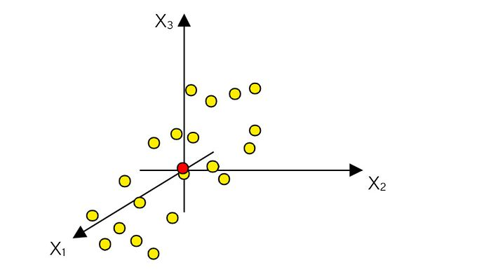
Principal Component Analysis
Subtract mean from the data points to change the centre of gravity of data called mean-centering
# Center the data
X = X - Xmean

Slide 13
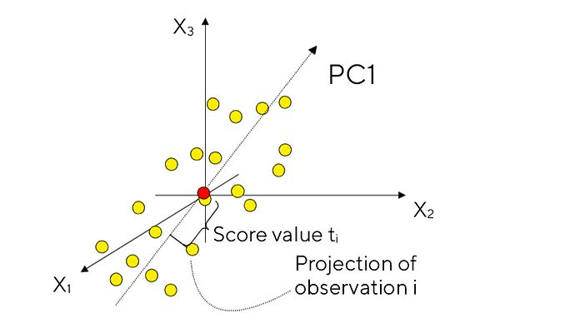
Principal Component Analysis
The 1st principal component PC1 is line passing through the centre and represents the flow of data points, covering major variance

Slide 14
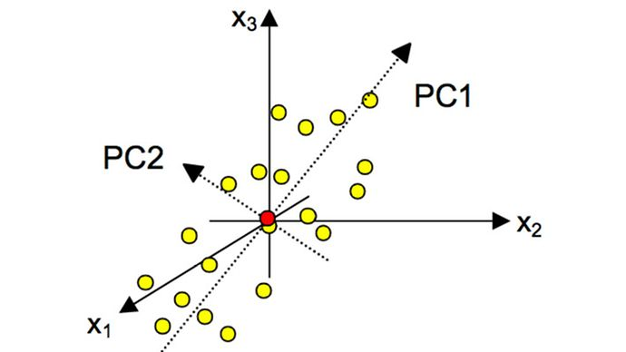
Principal Component Analysis
The 2nd principal component PC2 must be orthogonal to the 1st and covers the next maximum variance

Slide 15
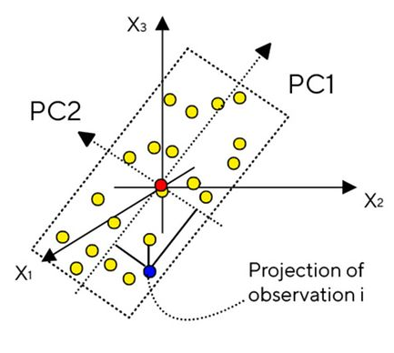
Principal Component Analysis
The two PCs make a region on smaller dimension d=2 which represents the projections of some data point on two PC lines.
# Step 3: Calculate the covariance matrix
covariance_matrix = np.cov(X, rowvar=False)
# Step 4: Finding Eigenvectors
D, V = np.linalg.eig(covariance_matrix)
D = np.real(D) # Diagonal elements
ind = np.argsort(D)[::-1] # Descending order sorting indexes
D = D[ind] # Rearrange
V = V[:, ind] # Rearrange
P = V[:, :nd] # Column-wise principal components
# Step 5: Deriving the new data set
Xnew = X.dot(P) # [N x d] x [d x nd] = [N x nd] matrix
Xnew1 = Xnew[:, 0]
Xnew2 = Xnew[:, 1]

Slide 16
PCA Matlab
Data Generation
N=20;
d=5;
nd=3; % new dimension
%step 1, generating a dataset
X=rand(N,d);

Slide 17
PCA Matlab
Mean Centring
Xmean=repmat(mean(X),size(X,1),1);
X=X-Xmean;

Slide 18
PCA Matlab
Finding covariance matrix and eigen values
%step 3, covariance matrix
covariancematrix=cov(X);
%step 4, Finding Eigenvectors
[V,D] = eig(covariancematrix);
D=diag(D);
[D,ind]=sort(D,’descend’);
V=V(:,ind);
V=V(:,1:nd); column-wise principal components

Slide 19
PCA Matlab
Finding projections
%step 5, Deriving the new data set
%finding the projection onto the eigenvectors
Xnew=X*P; [N x d] x [d x nd] = [N x nd] matrix
plot(Xnew(1),Xnew(2), title, ‘2D Projections’,xlabel,’PC1 projection’, ylabel,’PC2 projection’);

Slide 20
PCA Matlab
Calssification
For every class find its Xnew
Apply to any classifier e.g., KNN, GMM, NN, SVM etc as new multivariate data

Slide 21
Linear Discriminant Analysis (LDA)
Like PCA, LDA is a dimensionality reduction technique.
PCA finds the discrimination between data through orthogonal projections of data on PC vectors.
LDA finds the discrimination between data through projection with data point separation using class information.
PCA is unsupervised while LDA is supervised

Slide 22
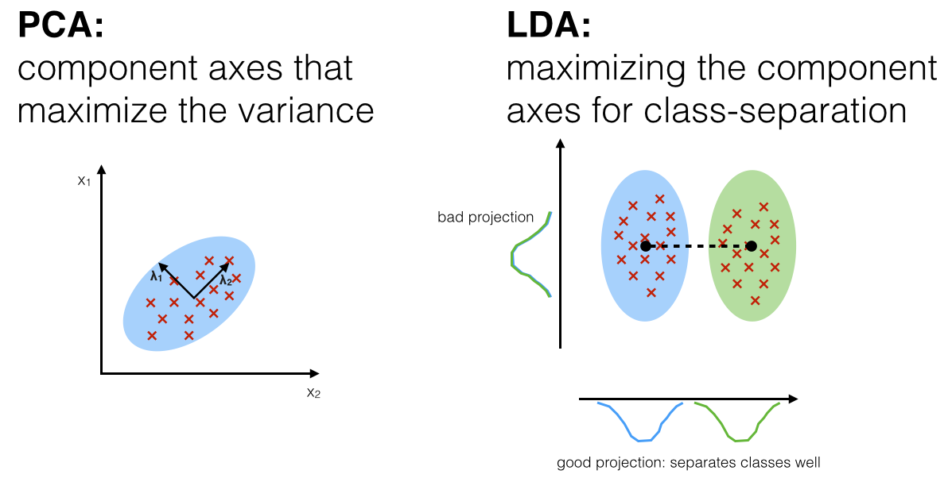
Linear Discriminant Analysis (LDA)

Slide 23
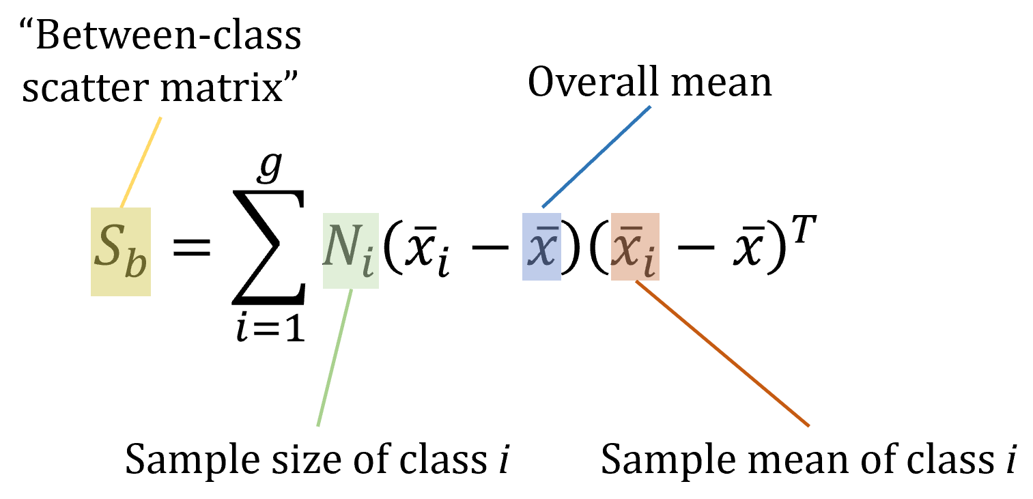
Linear Discriminant Analysis (LDA)
3-step process
1. Find the separation between the classes i.e., distance between the means of different classes

Slide 24
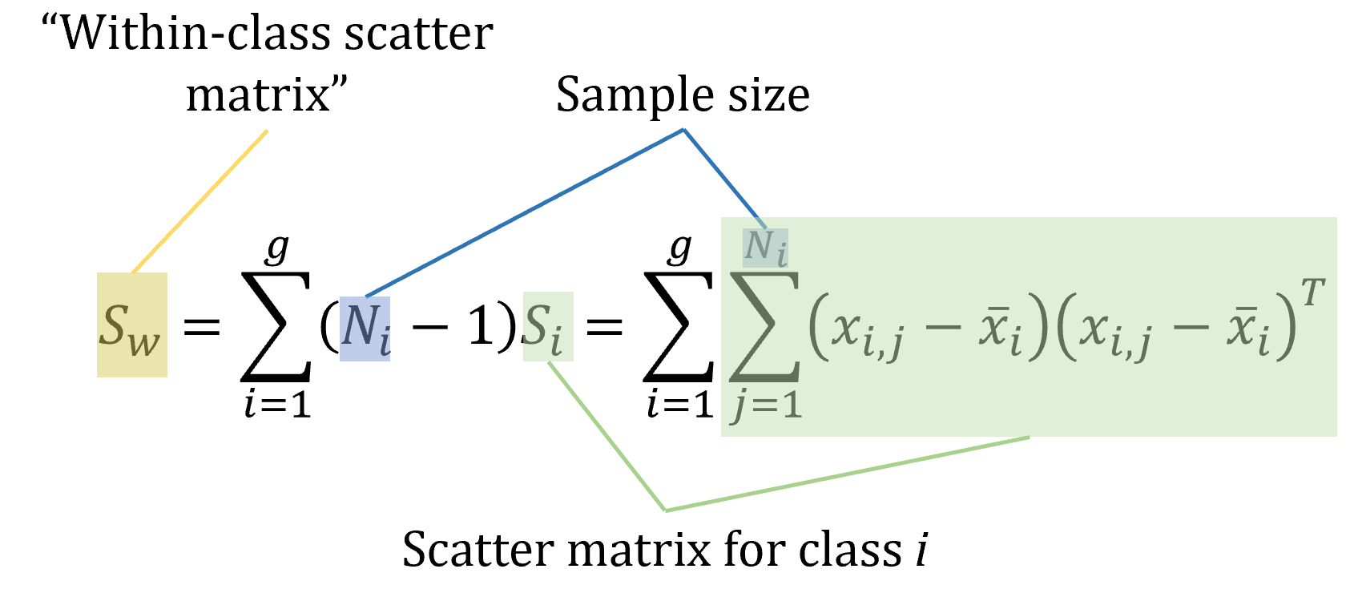
Linear Discriminant Analysis (LDA)
3-step process
2. Find the separation within the class i.e., distance between the mean and sample of every class

Slide 25
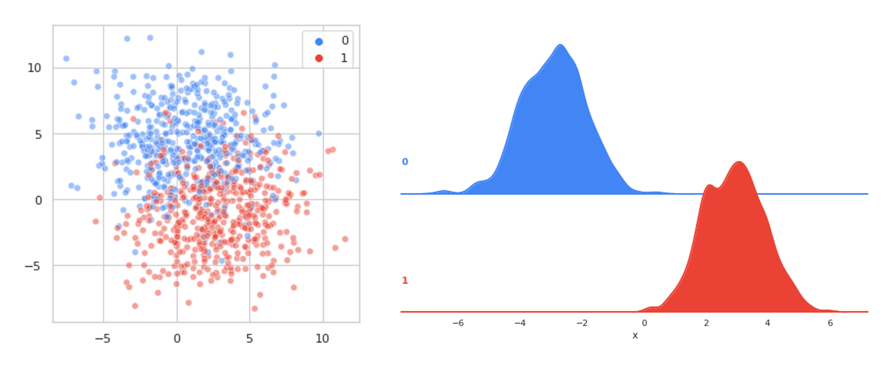
Linear Discriminant Analysis (LDA)
3-step process
3. Maximise the between-class variance (distance) and minimise the within-class variance (distance) via eigen value decomposition

Slide 26
Linear Discriminant Analysis (LDA)
import numpy as np
import scipy.io
import matplotlib.pyplot as plt
# Load the data
iris_data = scipy.io.loadmat('iris_data.mat')
X = iris_data['iris'][:, :4]
L = iris_data['iris'][:, -1]
# Linear Discriminant Analysis (LDA) function
def LDA_func(X, L):
Classes = np.unique(L)
k = len(Classes)
n = np.zeros(k)
C = []
M = np.mean(X, axis=0) # Overall mean
S = []
Sw = np.zeros((X.shape[1], X.shape[1]))
Sb = np.zeros((X.shape[1], X.shape[1]))

Slide 27
Linear Discriminant Analysis (LDA)
for j in range(k):
Xj = X[L == Classes[j]]
n[j] = Xj.shape[0] # Class sample size
Cj = np.mean(Xj, axis=0) # Class mean
C.append(Cj)
Sj = np.zeros((X.shape[1], X.shape[1]))
for i in range(int(n[j])):
diff = Xj[i] - Cj
Sj += np.outer(diff, diff)
S.append(Sj)
Sw += Sj
Sb += n[j] * np.outer(Cj - M, Cj - M)
W, LAMBDA = np.linalg.eig(np.linalg.inv(Sw).dot(Sb)) # Eigenvalue decomposition
lambda_ = np.real(LAMBDA)
SortOrder = np.argsort(lambda_)[::-1]
lambda_ = lambda_[SortOrder]
W = W[SortOrder]
Xnew = X.dot(W)
return Xnew, W, lambda_
Xnew, W, _ = LDA_func(X, L)

Slide 28
Linear Discriminant Analysis (LDA)
# Plot the 2D Projections
Y1 = Xnew[:, 0]
Y2 = Xnew[:, 1]
plt.scatter(Y1[L == 1], Y2[L == 1], c='b', s=50, label='Class 1')
plt.scatter(Y1[L == 2], Y2[L == 2], c='r', s=50, label='Class 2')
plt.scatter(Y1[L == 3], Y2[L == 3], c='g', s=50, label='Class 3')
plt.title('2D Projections')
plt.xlabel('LDA1 projection')
plt.ylabel('LDA2 projection')
plt.legend()
plt.show()

Slide 29
Linear Discriminant Analysis (LDA)
function [Xnew, W, lambda] = LDA(X, L)
Classes=unique(L)';
k=numel(Classes);
n=zeros(k,1);
C=cell(k,1);
M=mean(X); % overall mean
S=cell(k,1);
Sw=0;
Sb=0;

Slide 30
Linear Discriminant Analysis (LDA)
for j=1:k
Xj=X(L==Classes(j),:);
n(j)=size(Xj,1); % Class sample size
C{j}=mean(Xj); % Class mean
S{j}=0;
for i=1:n(j)
S{j}=S{j}+(Xj(i,:)-C{j})'*(Xj(i,:)-C{j});
end
Sw=Sw+S{j};
Sb=Sb+n(j)*(C{j}-M)'*(C{j}-M);
end
[W, LAMBDA]=eig(Sb,Sw); % Eig value decomposition
lambda=diag(LAMBDA);
[lambda, SortOrder]=sort(lambda,'descend');
W=W(:,SortOrder); % Here you can also truncate dimensions: W=W(:,1:nd);
Xnew=X*W;
end

Slide 31
Linear Discriminant Analysis (LDA)
%% Load Data
data=load('iris');
X = data.Inputs';
T = data.Targets';
L = vec2ind(T')';
%% Linear Discriminant Analysis (aka. Fisher Discriminant Analysis)
[Y, W, lambda] = LDA(X, L);
%% Plot Results
figure;
D = size(X,2);
for d=1:D
% Original Data
subplot(D,2,2*d-1);
plot(X(:,d));
ylabel(['x_' num2str(d)]);
if d==D
xlabel('Sample Index');
end
if d==1
title('Original Data');
end
grid on;
% Transformed Data
subplot(D,2,2*d);
plot(Y(:,d));
ylabel(['y_' num2str(d)]);
if d==D
xlabel('Sample Index');
end
if d==1
title('LDA Output');
end
grid on;
end

Slide 32
Linear Discriminant Analysis (LDA)

Slide 33
Neighbourhood Component Analysis (NCA)
Yet another powerful approach for dimensionality reduction.
Supervised approach i.e., class labels are needed.
In more complex nonlinear data (with intra-class dissimilarity and inter-class similarity), it performs better than other approaches including PCA and LDA.
The idea is same i.e., to map high dimensional data to lower dimensional data before subjecting it to some classifier.

Slide 34
Neighbourhood Component Analysis (NCA)
Given a multivariate data X with [Nxd] dimension matrix.
Initialise a mapping matrix A of [dxdim] dimension with random values.
dim <=d
We find the stochastic nearest neighbour of data points in transformed space. These data points are feature vectors in case of multivariate.

Slide 35
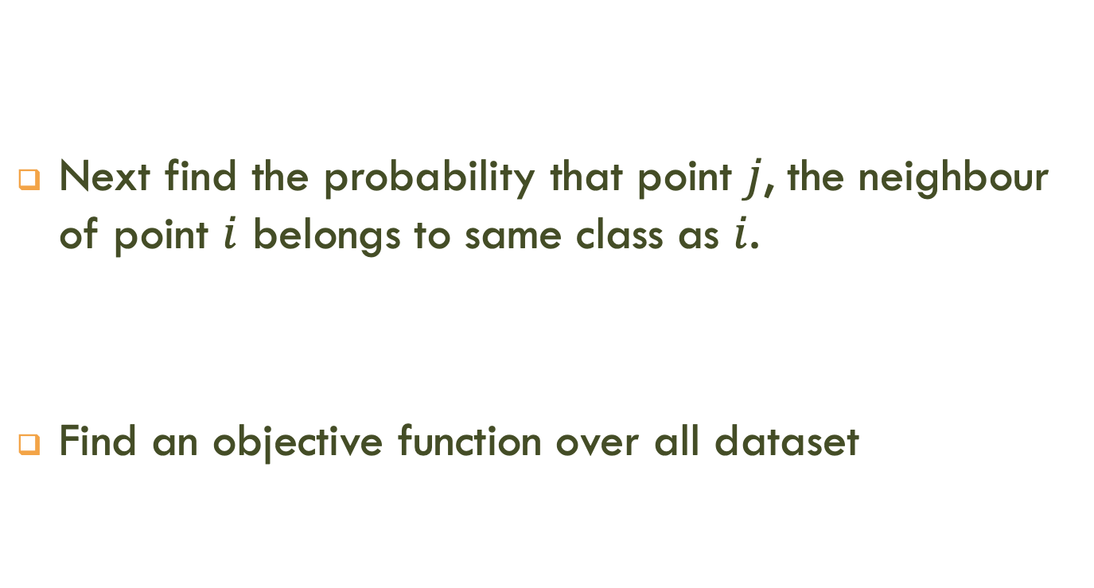
Neighbourhood Component Analysis (NCA)
Next find the probability that point $j$, the neighbour of point $i$ belongs to same class as $i$.
Find an objective function over all dataset

Slide 36

Neighbourhood Component Analysis (NCA)
Find A by maximisation
The new dimensional transformed data is
$$X_{new}=X_{old}A$$

Slide 37
Neighbourhood Component Analysis (NCA)

Slide 38
PCA, LDA, NCA in Python
sklearn.decomposition.PCA
sklearn.discriminant_analysis.LinearDiscriminantAnalysis
sklearn.neighbors.NeighborhoodComponentsAnalysis

Slide 39
Food of Thought
PCA, LDA and NCA are amongst the most successful non-neural network dimensionality reduction approaches.
You should keep in mind anther approach t-SNE. This is yet another approach with very promising results.

